Slide 1
Effective Learning in Higher Education to address contemporary challenges
By Geoffrey Shakwa
Head: Professional Development
E-mail: gshakwa@nust.na
By Maurice Nkusi
Acting Director: Teaching and Learning Unit
E-mail: mnkusi@nust.na

Slide 2
“If you always do what you’ve always done, you’ll always get what you’ve always got.”
Henry Ford
“To get what we’ve never had, we must do what we’ve never done.”
Anonymous
Do what you can with what you have and where you are.
Theodore Roosevelt

Slide 3
1. NUST vision in Teaching and Learning
3. Students’ Attributes
2. Teaching the Domains of Competence

Slide 4
NUST vision in Teaching and Learning

Slide 5
NUST vision in Teaching and Learning cont.
IOP Priories

Slide 6
NUST vision in Teaching and Learning cont.
IOP Priories

Slide 7
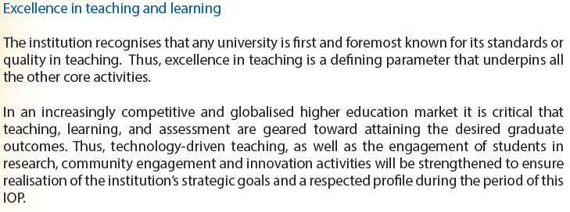
NUST vision in Teaching and Learning cont.
IOP Priories

Slide 8
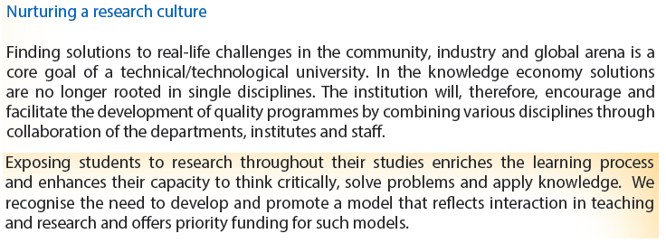
NUST vision in Teaching and Learning cont.
IOP Priories

Slide 9
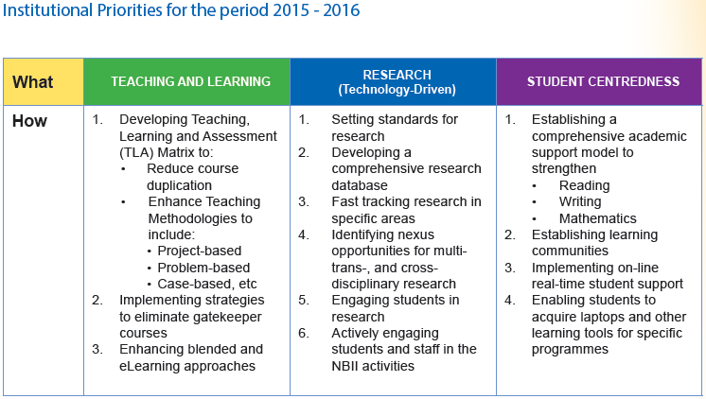
NUST vision in Teaching and Learning cont.
IOP Priories

Slide 10
Teaching – Learning - Assessment
Ability to think critically
Knowledge and skills
Ability to communicate effectively
Ability to predict future issues
What are we trying to achieve in TLA?
Ability to solve problems
Ability to actively participate in communities
Ability to work in local/ international teams (collaboration/team building)

Slide 11
NUST vision in Teaching and Learning cont.
Are traditional teaching methods right for today students given our vision as University of Science and Technology?

Slide 12
NUST vision in Teaching and Learning cont.
Who is today students?
Answers:
Not University prepared
More tech-savvy
They are less traditional

Slide 13
Today Students’ Expectations of University Experience
Prepare them for their careers
Relate to job competencies, job seeking and success
Be supported and enhanced by technology
Focus on application and transferable skills and not just acquiring knowledge

Slide 14
What Learning should address?
Research has shown that meeting the need of today students and preparing them for education, life and work means address three domains of competence:
Cognitive
Affective (intra and interpersonal)
Psychomotor

Slide 15
Cognitive Domain of Learning
Knowledge
Understanding
Applying
Analysing
Evaluating
Creating
Creativity
Critical thinking
Reasoning and argumentation

Slide 16
Affective Domain of Learning
Intrapersonal
Intellectual openness
Work ethics and conscientiousness
Self-efficacy
Persistence
Metacognition
Interpersonal
Communication
Collaboration
Leadership
Conflict resolutions

Slide 17
How to teach to these Domains of Competence
Provide clearly delineated learning outcomes and model of the learning process

Slide 18
How to Teach these Domains of Competence cont.
Represent content and concepts in various ways accompanied by learning activities

Slide 19
How to Teach these Domains of Competence cont.
Encourage elaboration, questioning, investigation and explanation.

Slide 20
How to Teach these Domains of Competence cont.
Engage students in challenging tasks while supporting them with appropriate scaffolding

Slide 21
How to Teach these Domains of Competence cont.
Teach with examples and case studies that bring home real world relevance and show concept at work.

Slide 22
How to Teach these Domains of Competence cont.
Prime student motivation by connecting with students interest, experience and aspiration

Slide 23
How to Teach these Domains of Competence cont.
Engage student in collaborative problem solving or other collaboration with the learning purpose.

Slide 24
How to Teach these Domains of Competence cont.
Providing meaningful and timely feedback and invite students to assess their own progress.

Slide 25
How to Teach these Domains of Competence cont.
Apply and provide students with meaningful exposure to the work environment through work integrated learning opportunities.

Slide 26
What are the Attributes of NUST Graduates?
These attributes are grouped in three main categories:
Specialist knowledge and skills focused on a particular career
Generic intellectual skills and capacities
Personal attributes

Slide 27
What are the Attributes of NUST Graduates? Cont.
Specialist knowledge and skills focused on a particular career:
• Mastery and application of discipline knowledge, principles and
concepts with internalised ethical behaviour, work ethics and codes of
professional and corporate conduct;
• An ability to identify, evaluate and solve problems in the field of study
and in unfamiliar contexts with understanding, insight and critical
reflection on current issues and debates related to the graduate’s
vocation;
• An innovative and entrepreneurial spirit and the ability to create jobs
in the graduate’s vocation;

Slide 28
What are the Attributes of NUST Graduates? Cont.
Specialist knowledge and skills focused on a particular career - Cont.
• An ability to make optimal use of information and communication
technology and to contribute to the various steps in technological
innovation;
• An ability to integrate theories and concepts with practical
applications and to understand the external and internal functioning
of a particular industry or profession.

Slide 29
What are the Attributes of NUST Graduates? Cont.
Generic intellectual skills and capacities
• A demonstration of critical, conceptual and reflective thinking,
intellectual openness and curiosity as evidence of lifelong learning
and decision-making, and conceptual, analytical and problem-solving
skills
• A capacity for innovation and creativity evident in the application of
knowledge and skill
• The ability to access, organise, synthesise, and evaluate and use data
and information effectively
• The ability to communicate effectively in English, both in writing and
verbally
• An ability to understand and interpret basic quantitative and
qualitative data and to make appropriate use of communication
technologies

Slide 30
What are the Attributes of NUST Graduates? Cont.
Personal attributes
• A love and enjoyment of ideas, discovery and learning
• An ability to work both independently and in collaboration with
others, while demonstrating self-discipline and an ability to plan and
achieve personal and professional goals
• Attitudes and communication skills that enhance effective
interpersonal relationships in personal, social and work contexts
• Self-motivation and self-management skills (time, stress, conflict
and others), and an appreciation and understanding of cultural
diversity

Slide 31
What is the role of technology to successfully teach the various domain of competence?
Technology is a tool to add value to various methods of teaching, learning and assessment.

Slide 32
What is the role of technology to successfully teach the various domain of competence?

Slide 33
What is the role of technology to successfully teach the various domain of competence?

Slide 34
Questions and Answers
END

