Slide 1
The Impact of RE & EE on the National Economy
November 2014
by
Harald Schütt
AMUSHA
CONSULTANCY SERVICES
amusha@iway.na
0811 291 223

Slide 2
"The problems that exist in the world today cannot be solved by the level of thinking that created them." –
(Albert Einstein)

Slide 3
Which questions do you have ?

Slide 4
The Impact of RE & EE on National Economy
This Presentation
People and Wealth in Namibia
Power Grid
Opportunities
The Bottom Line
What needs to be done
Conclusion

Slide 5
11.11.2009
Wage gap is growing, warns LaRRI
By: JO-MARÉ DUDDY
MINIMUM-WAGE earners belonging to trade unions on average had to make do with an increase of N$188 last year, but because of high inflation, the buying power of their monthly
N$ 2 190 dropped by more than three per cent compared to 2007.
For this they had to work an average of 44 hours per week.
Research shows that minimum wages were increased on average by 9,07 per cent last year. Average inflation for 2008 stood at 12,2 per cent, however – in real terms meaning that workers had 3,22% less money in their pocket.
continued

Slide 6
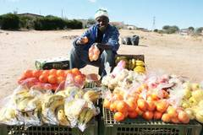
Marketplace News 16.01.2012
Average inflation for 2011 clocks at 5%
“There could also be upward surprises caused by electricity increases, which we believe has not been priced in yet.” SSS expects an average inflation rate of 7,2 per cent for 2012.
Last month’s increase was, as in most previous months, driven by a jump in food inflation. December’s figure stood at 9,2 per cent, up from 6,7 per cent the previous month. Inflation for bread and cereals, meat, milk, cheese, eggs and vegetables were all up: meat from 10,9 per cent to 11,1 per cent; cheese and eggs from 1,7 per cent to 3,6 per cent; and vegetables from 5,3 per cent to 9,9 per cent.
DOLLARWISE ... Consumers will have to count their pennies with economists warning that the price monster will become fiercer in the coming months..
Photo: Tanja Bause

Slide 7
Releasing its Wage Bargaining Report for 2008, LaRRI warned:
“Unless we start realising that a small minority cannot live in peace and happiness while the vast majority remains hungry and desperate, we will continue building the foundation for future disaster.”
Do we want to be part of the future or part of the disaster ?

Slide 8
People and Wealth in Namibia
Monthly income
for how many
13%
5.7%
>10'500
7.2 %
<10'500 Nam$
35 %
Source: BoN 2009
monthly < 4'600 Nam$
87%
52 %
monthly < 1'500 Nam$

Slide 9
People and Wealth in Namibia
Electricity users now on grid
How many people will still be able to afford grid-electricity when inflation bites and prices rise ? ! ?
5.7%
13%
>10'500
Per cent of population on grid now
7.2 %
<10'500 Nam$
≈ 33%
35 %
monthly < 4'600 Nam$
87%
52 %
monthly < 1'500 Nam$

Slide 10
People and Wealth in Namibia
50% = Realistic first target for Electricity users potentially using and contributing their own electricity to the National grid
≈ Per cent of population to directly benefit from REFiT and Net-metering plus all secondary jobs created
13%
5.7%
>10'500
7.2 %
<10'500 Nam$
35 %
≈50 %
Others could start using island solutions and small-scale networks in rural areas
monthly < 4'600 Nam$
87%
52 %
monthly < 1'500 Nam$

Slide 11
People and Wealth in Namibia
Population is growing !
Growing population will of course swell the ranks of the poorer part of society, and people who drop out of the system thus increasing exponentially the financial burden
for those, who remain on grid.
?< 10% ?
>10'500
>10'500
<10'500 Nam$
<10'500 Nam$
monthly < 4'600 Nam$
? ≈> 90 % ?
monthly < 4'600 Nam$
monthly < 1'500 Nam$
monthly < 1'500 Nam$

Slide 12

Power Stations in Namibia
ANGOLA
Baynes 600MW
ZAMBIA
Ruacana Hydro Run-of-the-river
Van Eck Coal fired Emergency and Standby
Paratus and Anixas Diesel & HFO Emergency and Standby
Ruacana 341MW
Rundu
Atlantic Ocean
Windhoek
Solar PV 10MW
Van Eck 128 MW
Erongo Coal 300MW
Paratus 24MW
BOTSWANA
Walvis Bay
Anixas22.5MW
Solar PV 10MW
Wind 60MW
Lüderitz
Wind 44MW
Existing Power Stations
Solar PV 10MW
Planned Power Stations
Kudu Gas 800MW
REPUBLIC OF
Oranjemund
SOUTH AFRICA

Slide 13
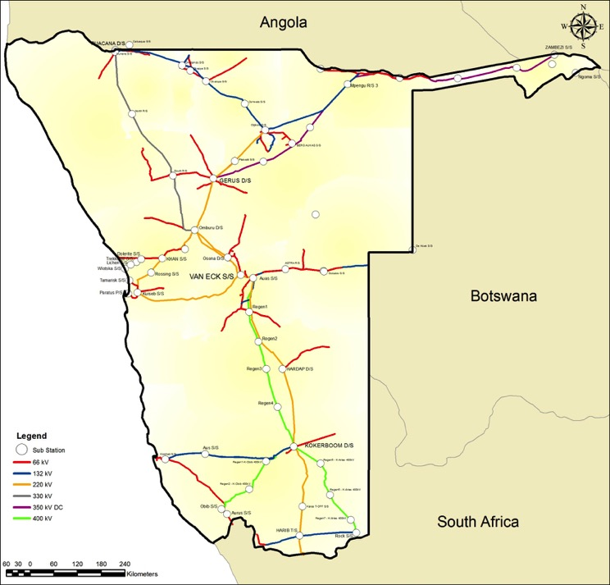
Omatando strengthening
Ph 1: N$ 12m, 2013/2014
Ph 2: N$814m, 2014/2015
Rundu Cuito 132kV
N$ 114 m, 2014/2015
Baynes Integration
N$1563m, 2030
SVC
2014/2015
2016/2017
2017/2018
2018/2019
2022/2023
Omatando Otjikoto 400kV
N$1088m, 2023
Caprivi Link Bipole
Auas Omburu Gerus 400kV
N$2509m, >2019
Gerus Otjikoto 400kV
(Operate at 220kV)
N$472m, 2014/2015
Auas Gerus 400kV
N$863m, 2016/2017
West Coast strengthening
N$ 376m, 2014/2015
Kudu deep connection
N$2407m, 2018/2019
Kudu shallow connection
N$1538m, 2017/2018

Slide 14
Funding Plan 2014 - 2020
Capital requirements
  NamPower Balance sheet: N$13,1 billion (N$5bn will be debt)
  IPPs financing (including Kudu equity and loans): N$15,6 billion
  Total: N$28,7 billion
NamPower source of funding
  Cash reserves
  Cash generated from operations
  Debt (DFIs, Bonds)
  Shareholder (equity capital and revenue support if necessary)

Slide 15


Structure of Supply now = 2014
> 2.4 Billion Nam$ per Year
Import
+
NamPower
REDs/Municpalities
Users Users Users Users Users
$
$
$
$

Slide 16
Namibian Transmission Back bone
ANGOLA
ZAMBIA
Ruacana
Otjikoto
Zambezi
Otjikoto
Otjikoto
Gerus
Omburu
BOTSWANA
2
Khan
2
van Eck
Rössing
Red – 400kV
Blue – 330 kV
Yellow - 220 kV
Brown – 350kV HVDC
Walmund
Auas
Kuiseb
2
Hardap
2
Kokerboom
Kokerboom
Atlantic Ocean
REPUBLIC OF
SOUTH AFRICA
Obib
2
Aries
Aggeneis
To Hydra
To Koeberg

Slide 17
Caprivi Link Interconnector
200/400MW
Hwange
(Zimbabwe)

Slide 18
Central Energy Supply Today

Slide 19
Why not like this:

Slide 20
Or even like this

Slide 21
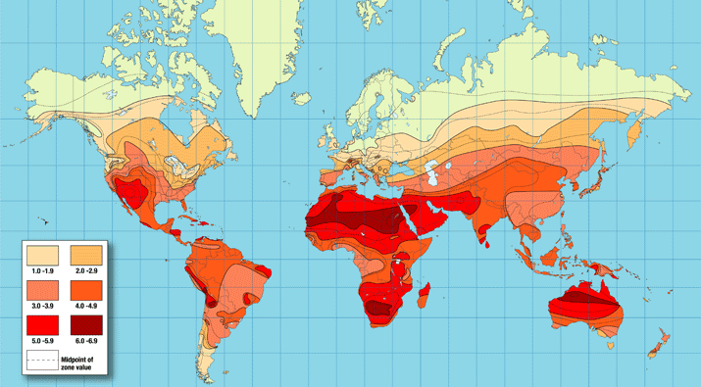
Opportunities
This solar radiation map shows the amount of solar energy in hours (peak sun hours),
received each day on an optimally tilted surface during the worst month of the year.
(Based on accumulated worldwide solar radiation data.)

Slide 22
Solar Energy Potential
Namibia’s Renewable Energy (RE) potential is substantial!
Solar Energy Potential
~ 1 800 000 TWh/a
Total energy use:
~20 TWh in 2011
~ 1 800 000 TWh/a
~20 TWh /a
~1 799 980 TWh/a
for export
Source: Map by GeoModel Solar, provided by REEEI

Slide 23
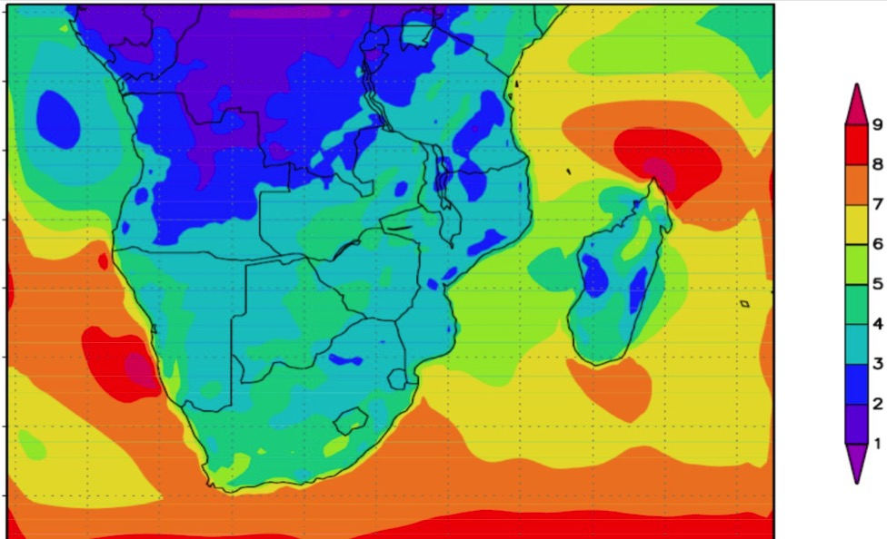
Opportunities
Windmap of Southern Africa

Slide 24
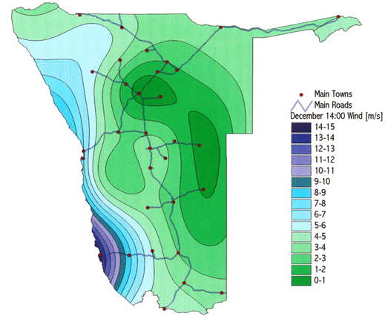
Wind Energy Potential Namibia
Namibia’s Renewable Energy (RE) potentials are substantial.
Wind Energy Potential
~ 1 TWh_{e}/a
~ 0.2 TWh_{e} /a
per 100 MW installed capacity
Source: Detlof von Oertzen & Reimo Bauer, 1999

Slide 25
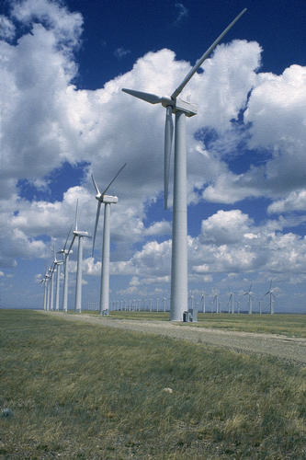
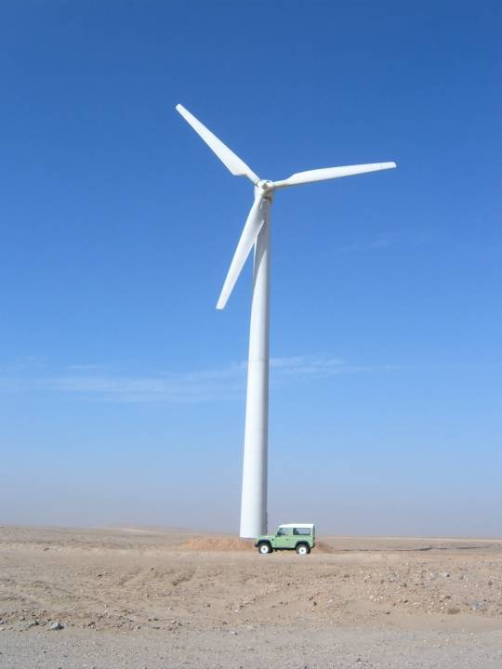
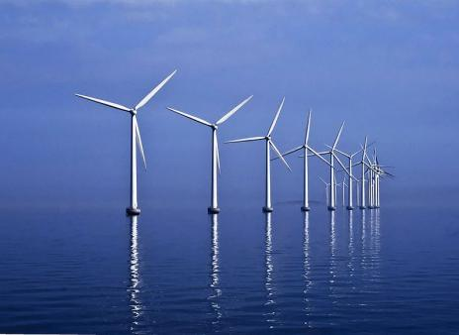
Opportunities
WindPower can supply MegaWatts !
But only
220 kW in Walvis Bay

Slide 26
Opportunities
Bush-to-electricity

Slide 27
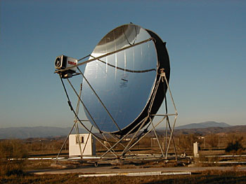
Opportunities
Stirling Motor
(can be manufactured
in Namibia, creating jobs)
Dish-Stirling technology,
30 to 50 kW per unit
No water needed
Must follow the sun precisely
Can use ANY source of heat:
Sun
Vegetable oil
Gas
Geothermal heat
Wood
Charcoal
etc.

Slide 28
Further Opportunities
Biogas
  Large scale
  Medium scale = farm size
  Small scale = household level
  Biofuels
    Castor
    Other oil crops
    Create MANY jobs !!
Biogas Digesters at a huge Commercial Farm

Slide 29
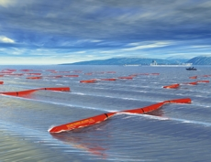
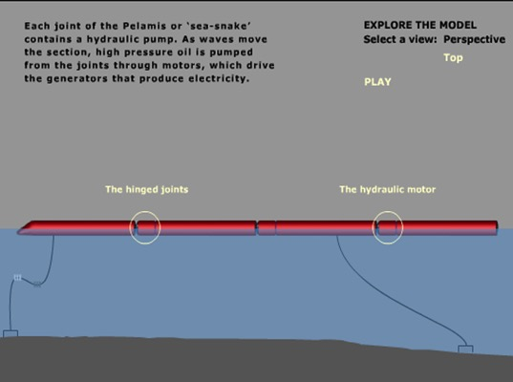
Further Opportunities
Wave energy
Should be explored and adapted to Namibian conditions

Slide 30
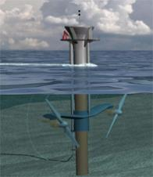
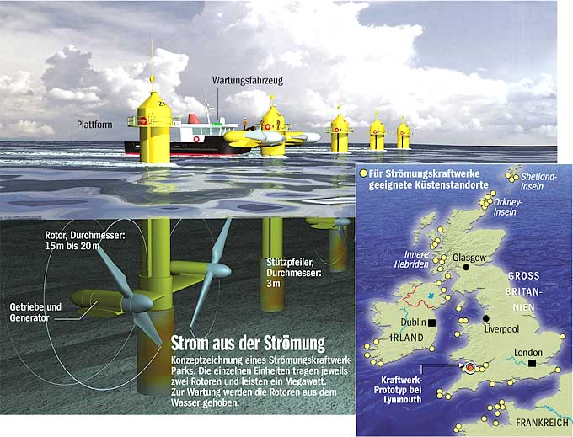
Future Opportunities
Ocean Stream

Slide 31
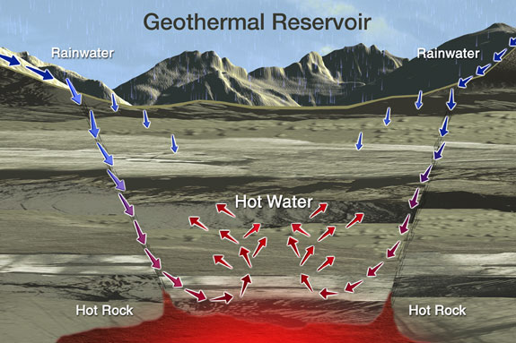

Slide 32
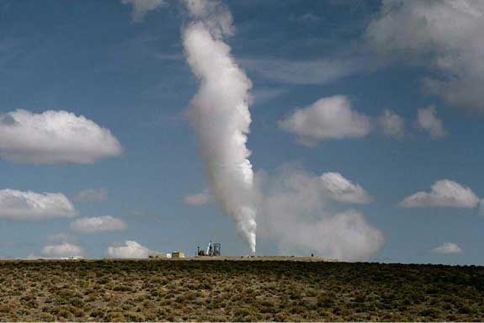

Slide 33
The Bottom Line
Source: VO Consulting

Slide 34
The Bottom Line
Source: VO Consulting

Slide 35
People and Wealth in Namibia
Electricity users now on grid
How many people will still be able to afford grid-electricity when inflation bites and prices rise ? ! ?
5.7%
13%
>10'500
Per cent of population on grid now
7.2 %
<10'500 Nam$
≈ 33%
35 %
monthly < 4'600 Nam$
87%
52 %
monthly < 1'500 Nam$

Slide 36
The Bottom Line

Slide 37
The Bottom Line

Slide 38
The Bottom Line

Slide 39
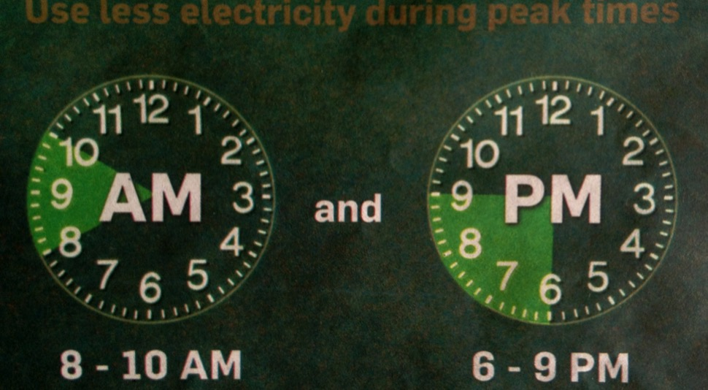
The Problem

Slide 40
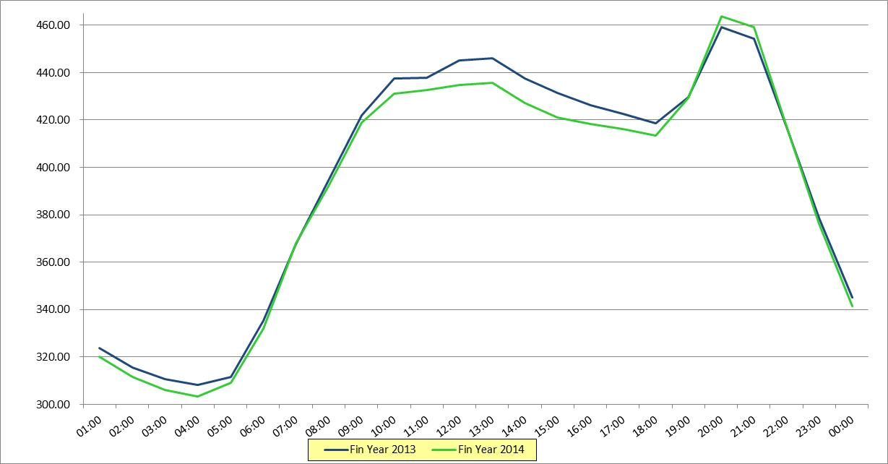
  Current Impact of RE on NamPower Demand

Slide 41

Demand for electrical energy is outstripping the available supplies.
We need to resolve how we want to power the nation into the future.
Namibia’s development is shaped by our electricity supply choices.
The electricity sector crisis is an opportunity to enhance the log-term viability of the sector and add to our national development.
Source:

Slide 42
The most important slide

Slide 43
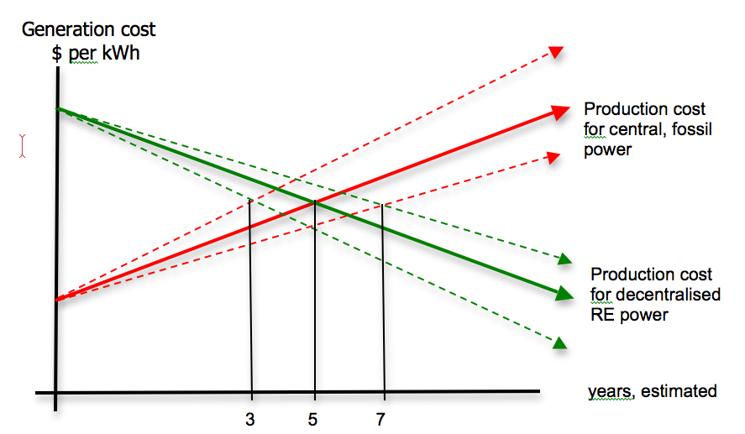
How to Finance RE & EE in Namibia
Marketprice
We KNOW that in RE is cheaper than fossil and nuclear because the very source of energy is free and renewable. We need only to finance the initial investment.
50 % Profit
50% payback
LET’S START WITH
10% OF TIPEEG = 1.5 BILLION NAM$
The 50 % will pay
back the initial money over time.
1
3
5

Slide 44
  How to Finance RE & EE in Namibia
Calculated over approx. five years, ANY renewable solution is cheaper per kWh than ANY fossil or nuclear generation
In order to mobilise private capital, and prevent capital outflow, we must create favourable and secure conditions for investment in Renewable Energy = REFiT (Renewable Energy Feed-in-Tariff)
For that, I propose a fund under a section 21 company that will subsidise every kWh produced up to the level of break-even for the producer = an insurance against losses.
The producer must – in turn – pay 50% of the profits back to the fund to be used for
  Other projects in RE and EE
  Research and Development
  (find Namibian solutions to Namibian problems)
  Bursaries, Training and Human Resource Development
  Marketing and Information about RE & EE
  Start with 10% of TIPEEG!
  The money will ultimately come back, because there is no end to the triangles! THAT would be productive usage of public funds !

Slide 45
For Investors
Renewable Energy gives secure conditions:
  No risk of price increases for fuel
  No risk of fluctuating exchange rates
  Calculable high output over 25 years and more
  Increasing demand for energy and related services
  Decreasing cost per kWh as capital cost is repaid
PREDICTABILITY of Price for decades =
= THAT will trigger FDI in many areas
Energy Efficiency:
    Energy autonomous housing => HeXagon housing
      Solar powered floor heating
      Aircon without electricity
    Solar Water heaters Made in Namibia
    Solar Cooking and Commercial Baking
Electro-mobility

Slide 46
How to get there ?
What do we need ?
Grid management (= smart grid) and generation needs to be separate and independent entities
We need a Renewable-Energy-In-feed-Tariff (REFIT) that makes it viable to invest in RE !
Access for willing investors to join the market
Introduction of “life-cycle-costing” instead of “cheapest offer” and “never mind the running cost”.
Independent Power Producers must be invited and encouraged rather than frustrated by complicated and lengthy negotiations
CLEAR COMMITMENT FROM GRN FOR RE & EE
International support
Investors, who think “out of the box”.

Slide 47
What needs to be done ?
ENERGY EFFICIENCY FIRST !
  Reform of Building codes !
    All buildings must be optimised towards energy use
    (=> massive savings in running cost)
    Build them in a way that they don’t get hot – instead of AirCon
    Include PV in the roof structure from the beginning
  Replace ALL electrical Water Heaters with SWH = 100’000 units nationwide
    (Would make local production of SWH viable)
  Roll out massive LED programme
  Encourage replacement of electrical cooking with gas/direct Solar Cooking
Smart Grid Management
Assist Industry to modernise equipment and re-organise work-processes.
  Time of use tariff to make power cheaper when the sun shines.
Assist the Nation in investigating EE-Cooling
Etc.

Slide 48
ENERGY EFFICIENCY
Is another full presentation:
Building codes
Transport
  Prevention of transport
  Pricing of transport
  Power for transport
Waste management
etc.
Can create MANY jobs locally ! ! ! !

Slide 49
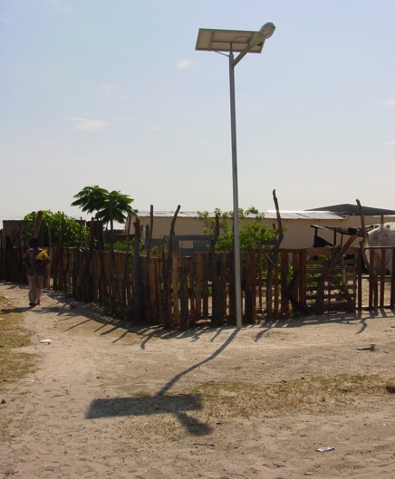
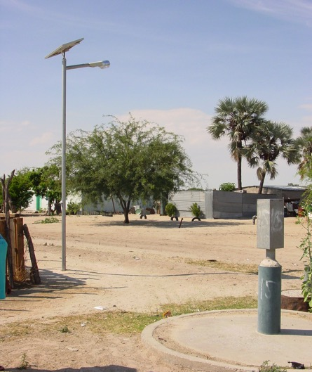
Why not ?
Have Solar Street Lights ? Made in Namibia ?

Slide 50
What needs to be done ?
We need a drastic reform of our tax-system in such a way that some of the VAT and a portion of the income tax remains in the regions where they are generated for the municipalities so support their operations.
The times, when they could use surplus margins from electricity and water to cross-subsidise their operations, are over.
But that is another full presentation.

Slide 51
What needs to be done ?
Generation of 100% Electricity from Renewable Sources
Work out an desired Generation mix of
  PV on rooftops
    100’000 roof programme = every house should be a power Station
      Requires only country-wide net metering
      Will channel considerable funds down the income pyramid
      Will create massive jobs in the country
  PV 5 – 50 MW in all corners of the country
CSP
  15 - 150 MW
  50 – 500 MW + storage

Slide 52
What needs to be done ?
Bush-to-electricity
  Facilitate 1‘000 small-scale generators in farmsize
  = 100 – 1‘000 KW
Wind
  150 MW in Lüderitz
  Walvis Bay ?
  Small vertical axis technology 1- 10 KW all over the country
Biogas at abattoirs, Feedlots and sewage works

Slide 53
What needs to be done ?
Explore
  Wave Power
  Ocean Stream Energy
  Geothermal resources
  others

Slide 54
What needs to be done ?
The grid:
  SMART GRID MANAGEMENT !
  Invest on Micro- Mini- and local grids instead of gigantomanistic Power Highways with high losses.
  Introduce electronic control devices to synchronise input into the Grid from small and big sources
  Investigate storage capacities:
    Batteries (household and large scale)
    Airpressure
    Gravity Power Pump Storage
    Heat Storage (CSP)
    Etc.

Slide 55



Recommended Structure of Supply
Import
+
NamPower
REDs/Municpalities
Users Users Users Users Users
$
$
$
$
$
$
$
$
> 2.4 Billion
Nam$ per Year
$
$
$
$

Slide 56
What needs to be done ?
The New Role of NamPower:
  Manage supply and demand on National Level
  Manage transition from Namibia as an importing country to a Power exporting country
    (earn income from selling Namibian RE-power to others, not by buying from them and selling with a mark-up to Namibians)
  Support REDs and Municipalities an ECB in the implementation of new structures for Power supply.
  Other tasks tbc

Slide 57
Conclusion
This country is at a crossroad:
  Either we go – and PAY– for the same mistakes that the old industrialised economies did, meaning we try to install a centralised, fossil based electricity supply system nationwide, which is even more problematic here than elsewhere because of our low population density and wide-spread poverty
  Or we smell the coffee and learn from new developments that our previous colonisers paid for dearly, meaning we opt for a de-centralised, Renewables based concept, that will produce electricity where we need it and keep the money circulating among Namibians instead of taking it out to benefit a few of us and finance development elsewhere.

Slide 58
Conclusion
The future has already started, the world is on the move because the old fossil systems simply cannot deliverany longer, they are financially risky = unpredictable and detrimental to climate and environment in short: UNsustainable.
Namibia has not (yet) done all the mistakes the industrialised countries have done and are paying for these days ! ! !
Namibia must choose to either be part of the past by repeating the mistakes the fossil industrialised society has done
or be part of the future
The future industrialised society will be based on Renewable Energy generation in conjunction with Energy Efficiency
RE + EE will also create jobs for Namibians by establishing value chains for the majority of the people rather than further concentration of wealth in the hands of the few
With Renewable Energy, the majority wins

Slide 59
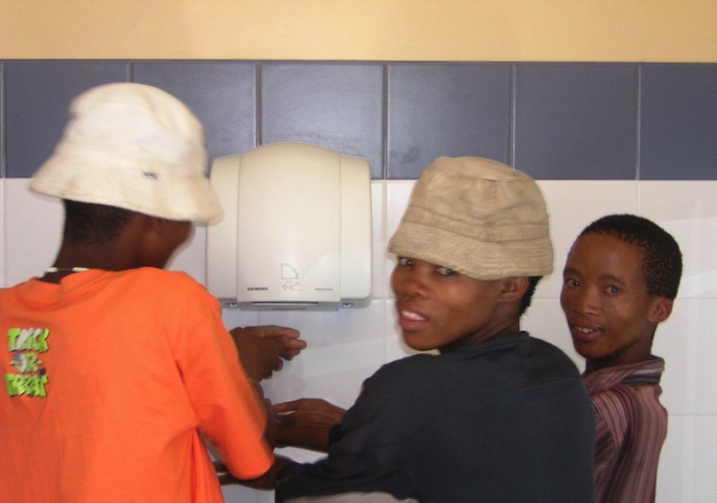
  European Solution for African Problem

Slide 60
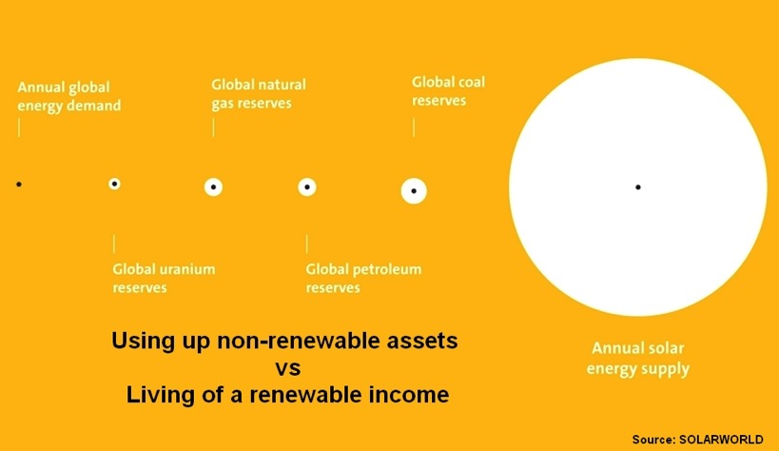

“The future is the time with less and less conventional energy available”
Notes:
Energy resource situation
This is what we do.

Slide 61
Thank you !
Which questions do you have ?
AmushA
Consultancy Services
0811 291 223
amusha@iway.na

